Slide 1
Path variables are a critical part of creating REST resources.
We use it using annotation called “PathVariable”
Whatever value we are passing in is being picked up by the controller.And it is being sent back in the response.

Slide 2
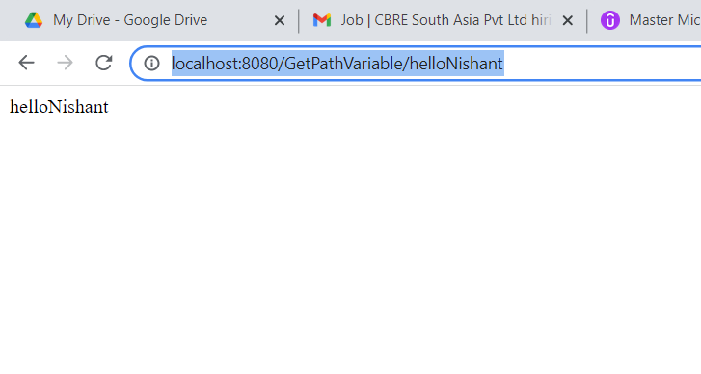
// displayPathVariable
@GetMapping(path = "/GetPathVariable/{pathVariable}")
public String GetPathVariable(@PathVariable String pathVariable) {
return pathVariable;
}

